Slide 1
CODE RED – MOCKDRILL
(SURPRISED)
Date:
SCREENSHOTS OF VIDEO
MODI MULTISPECIALITY DENTAL CLINIC

Slide 2
1
Announcing and Activating Code Red 3-Times and
informed to reception desk by speed-dialing no.02

Slide 3
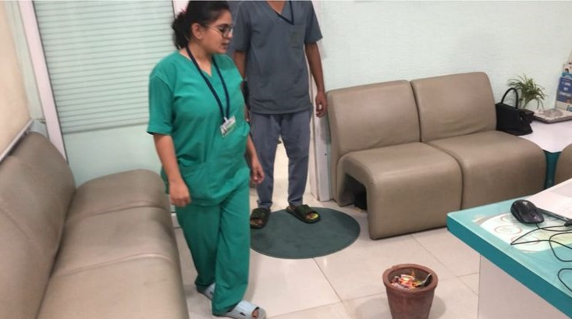
2
An individual giving the information for CODE RED “exact location of the FIRE” at least three times.

Slide 4
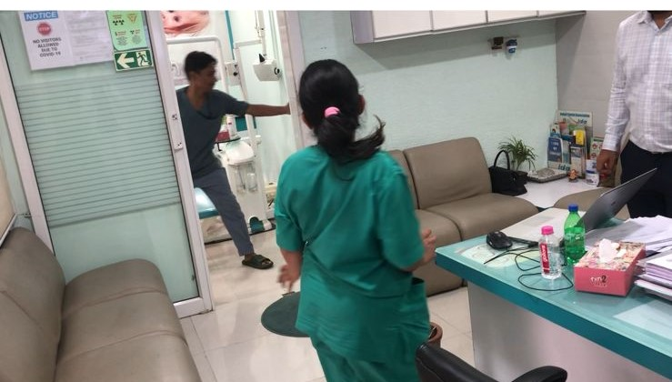
3
Safety Officer take charge and Announce for Opening all the Doors and Clearing the Exit Way

Slide 5
4
ON DISCOVERING A FIRE:
R – Rescue anyone who is in immediate danger.
A– Active the nearest fire alarm
C – Confine or contain the fire by removing all the things which can catch fire.
E – Extinguish the fire by using a portable fire extinguisher or use Evacuate through Fire exit routes to escape from a large fire.

Slide 6
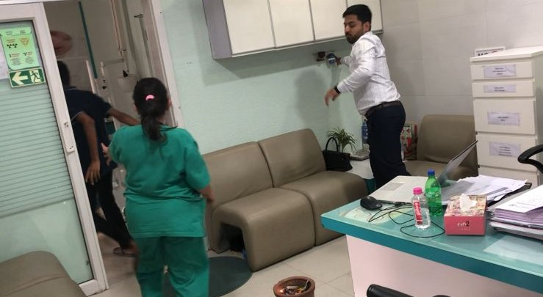
5
Electricity supply and ON lights need to be OFF/Stop/Close/Cut-off immediately.

Slide 7
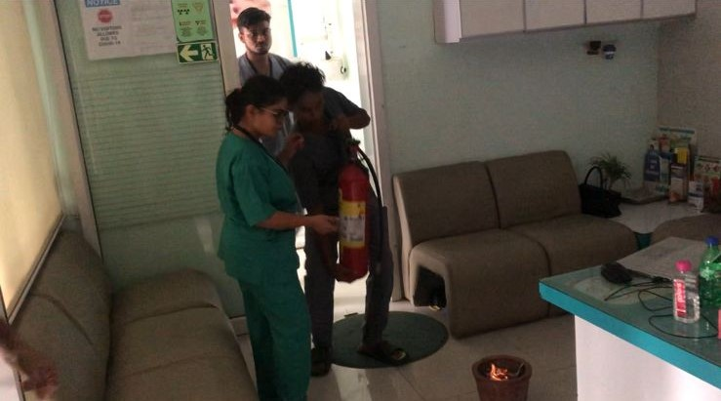
6
Safety Officer shall immediately reach to the location of Fire to extinguish the fire.
Dental Assistant is bringing the fire extinguisher at the site.

Slide 8
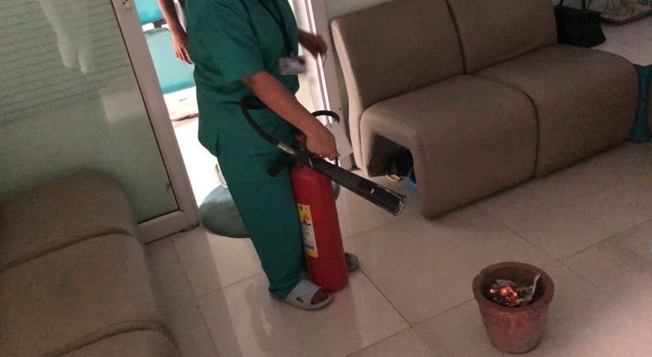
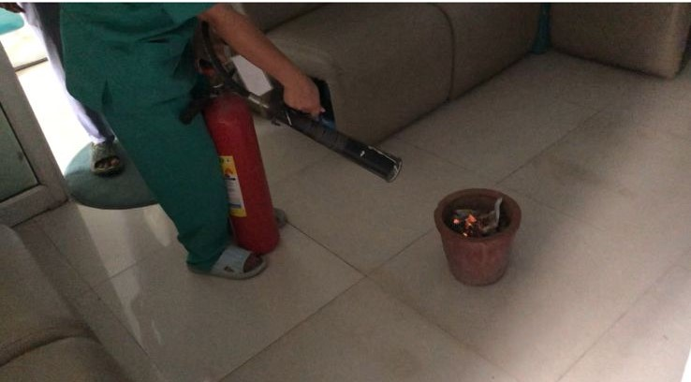
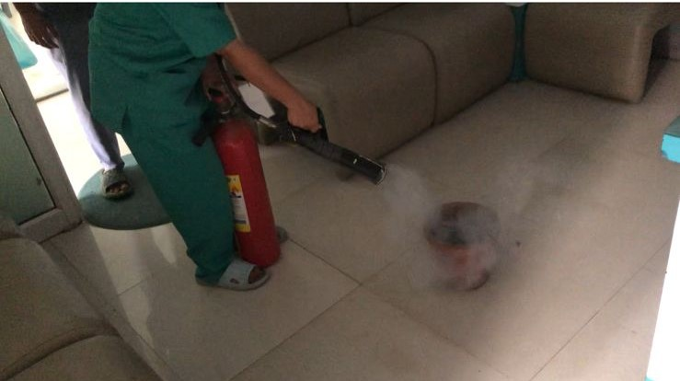
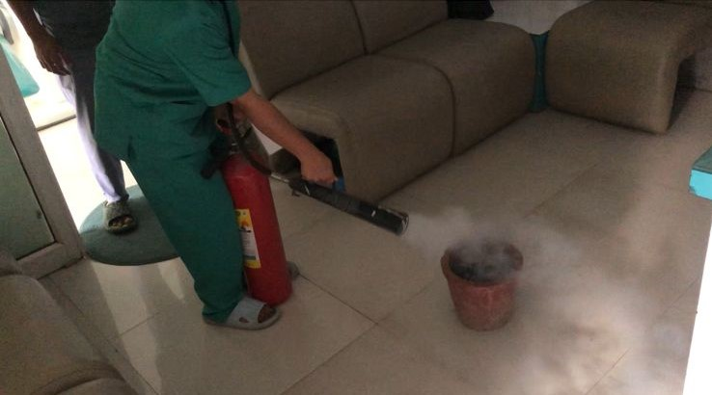
7
P-Pull the Pin
A-Aim to the base
S-Squeeze the knob
S-Sweep side to side

Slide 9
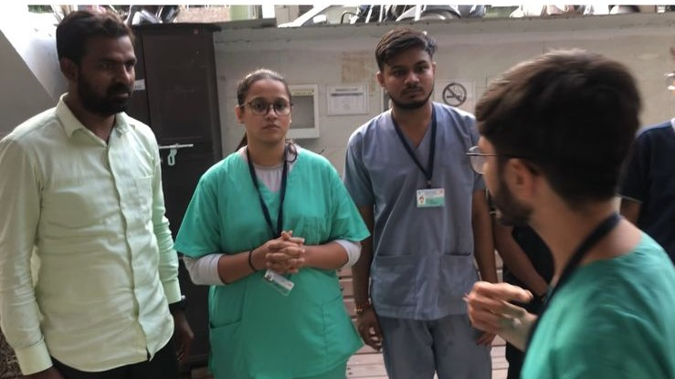
8
Meanwhile, In-charge Doctor is counting the number of people were present at the site – outside the clinic at Triage area.

Slide 10
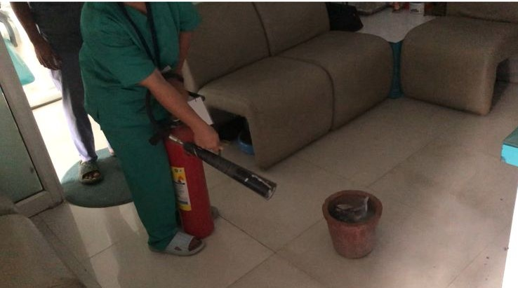
9
Fire is stopped

Slide 11
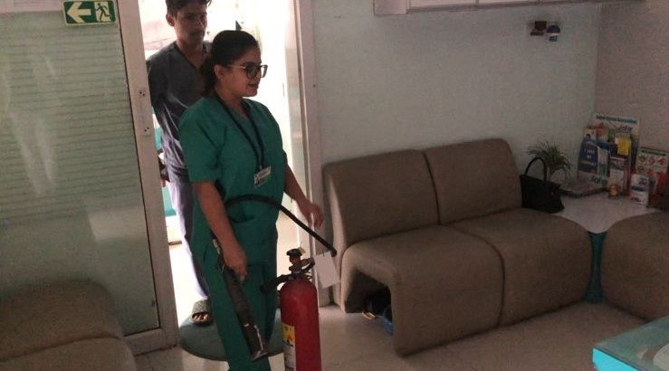
10
Fire and Safety Officer in consensus with Chair-person is authorized to declare for Deactivate code Red and call to operator for deactivation of code Red.
Code is Deactivated and announced 3 times. Also Speed-dial No.2 to inform Receptionist.

