Slide 1
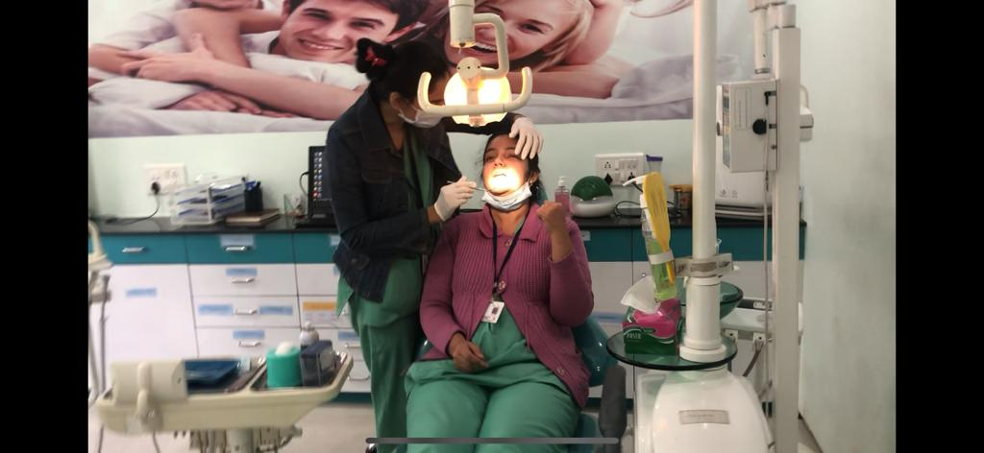
DENTIST /
DOCTOR
PATIENT
CHECK ORAL DIAGNOSIS OF PATIENT

Slide 2
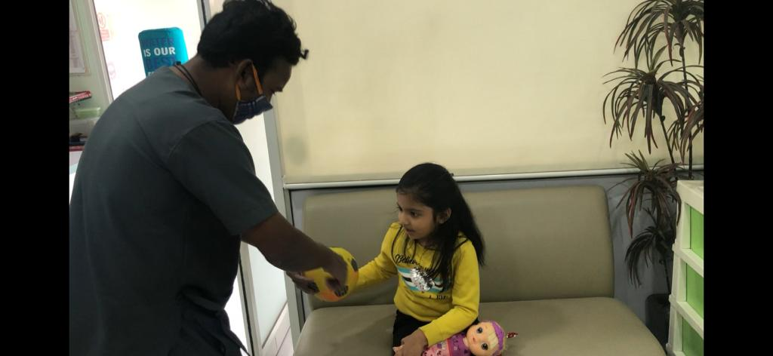
THIEF
CHILD
THIEF NOTICED CHILD WITHOUT HER GUARDIANS

Slide 3
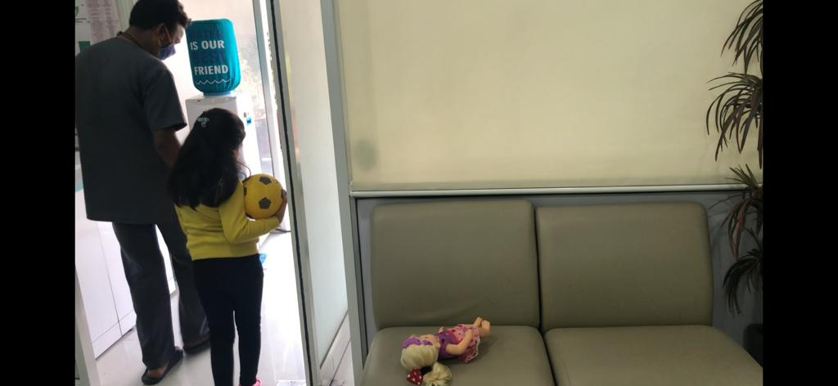
THIEF TOOK HER WITH HIM AND ATTEMPT CHILD KIDNAPPING

Slide 4
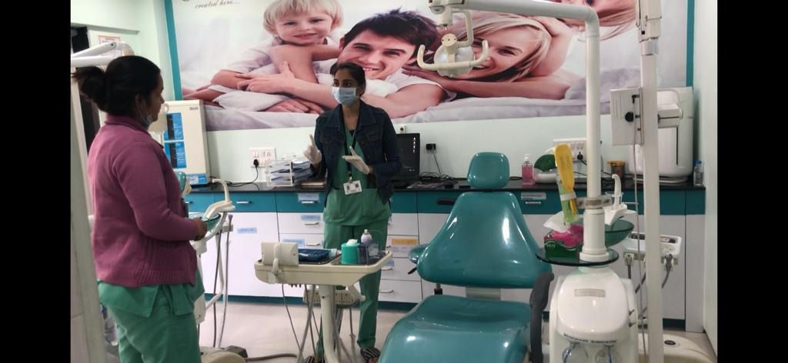
GIVEN POST INSTRUCTIONS AFTER COMPLETE TREATMENT

Slide 5
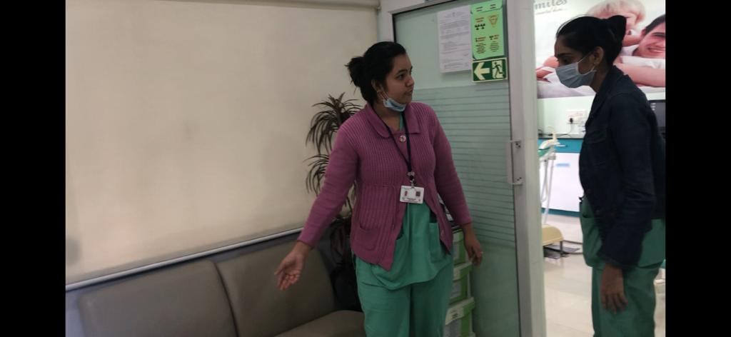
MOTHER NOTICED HER CHILD MISSING IN CONSULTING AREA

Slide 6
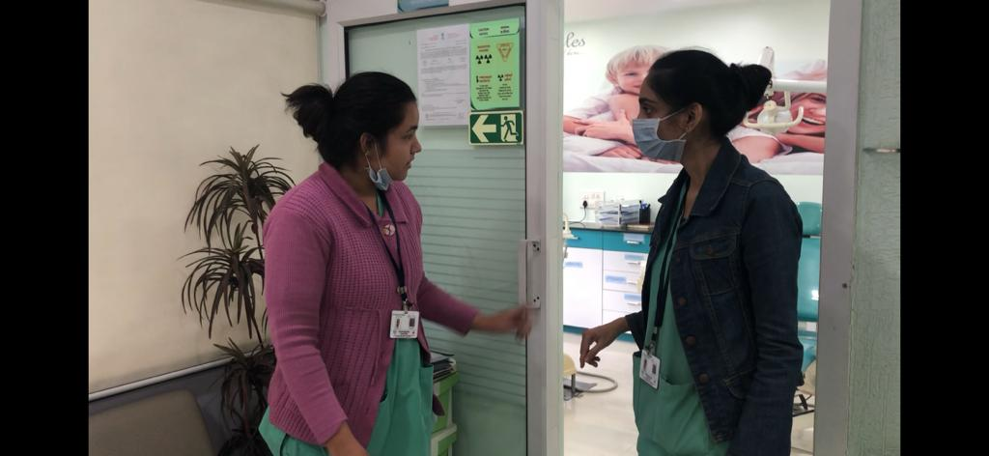
CONFIRMED CHILD MISSING AND TAKE INFORMATION ABOUT AGE , LOOK OF MISSING CHILD.

Slide 7
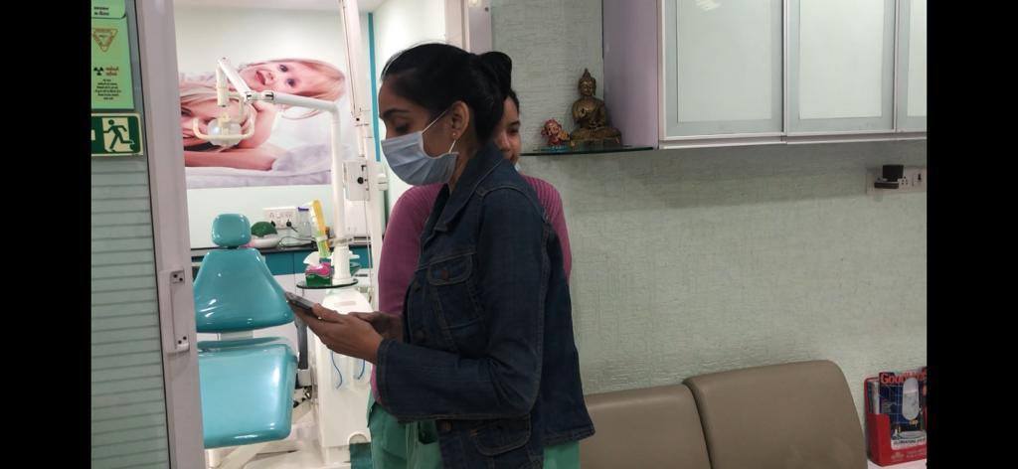
NOTICED THAT CHILD MISSING AND IMMEDIATELY ACTIVATE CODE PINK BY DIAL-02.

Slide 8
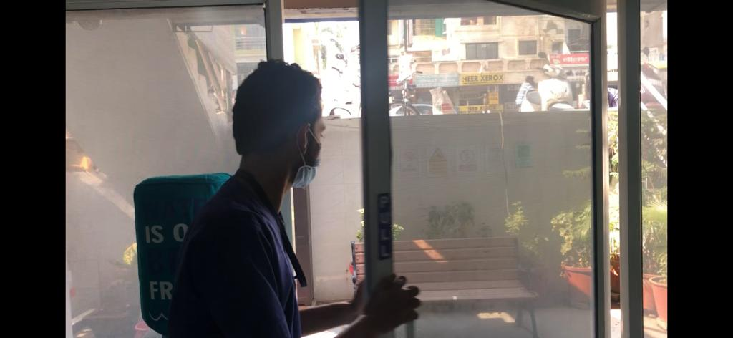
AFTER ACTIVATE CODE PINK RECEPTIONIST CLOSE THE DOOR AND STOP THE ENTRY OF ANY PATIENTS , VISITORS.

Slide 9
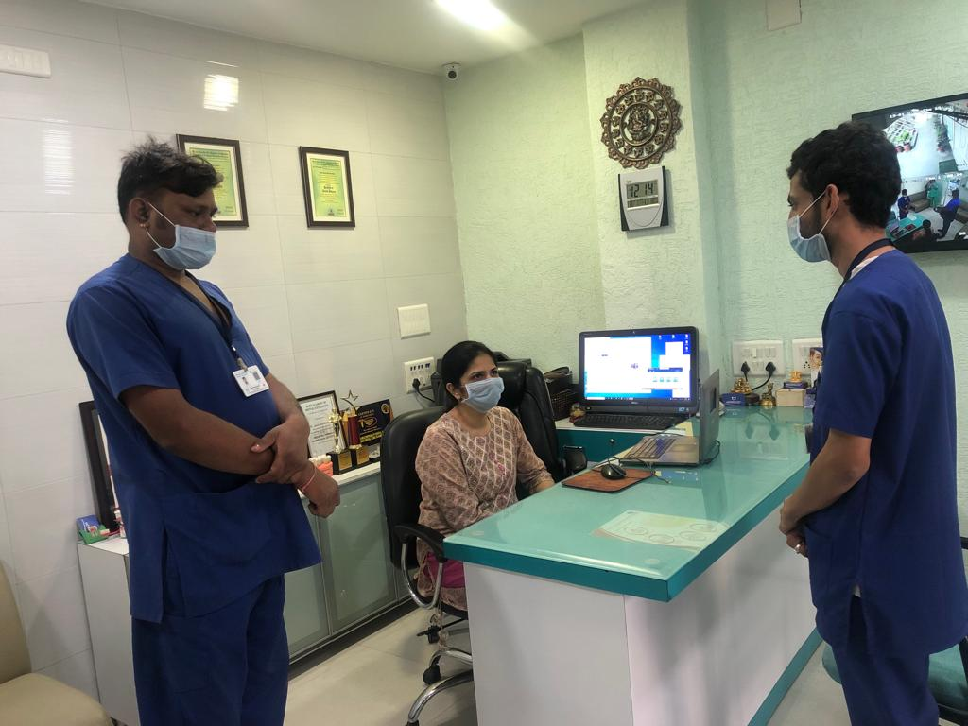
INFORM HEAD OF CLINIC AND SAFETY OFFICER ABOUT MISSING CHILD

Slide 10
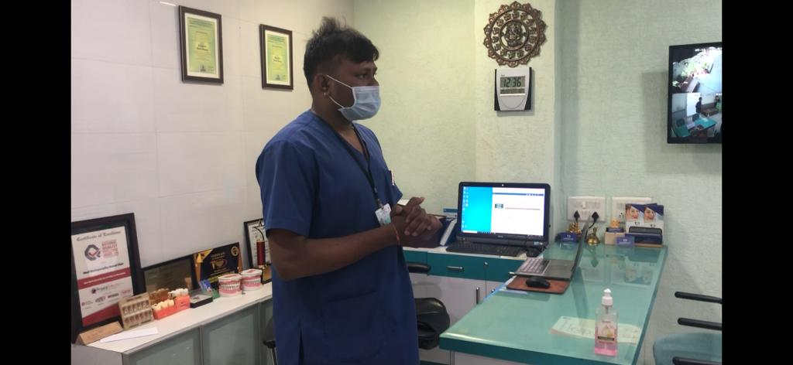
SAFTY OFFICER TAKE INCHARGE OF MISSING CHILD

Slide 11
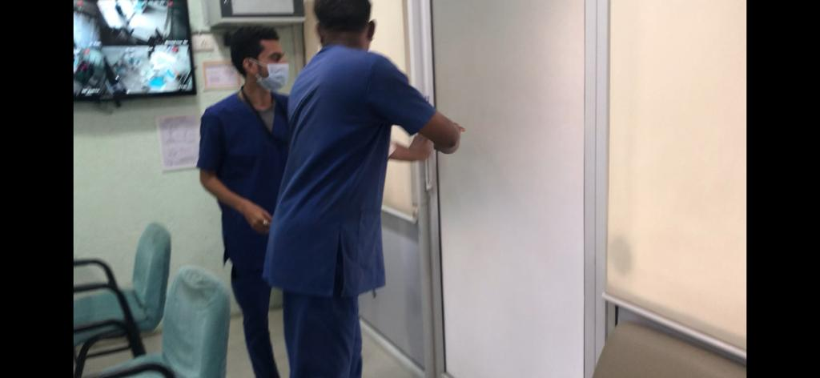
SAFETY OFFICER CONDUCT TO SEARCH MISSING CHILD AND CLOSE ALL EXITS.

Slide 12
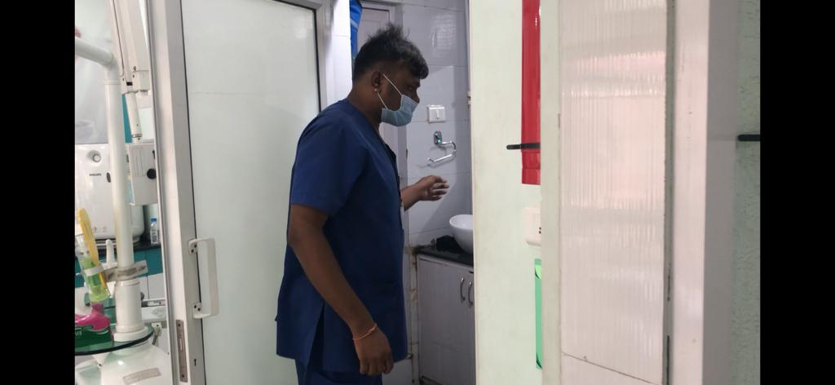
CONDUCT SEARCHING IN PENTRY

Slide 13
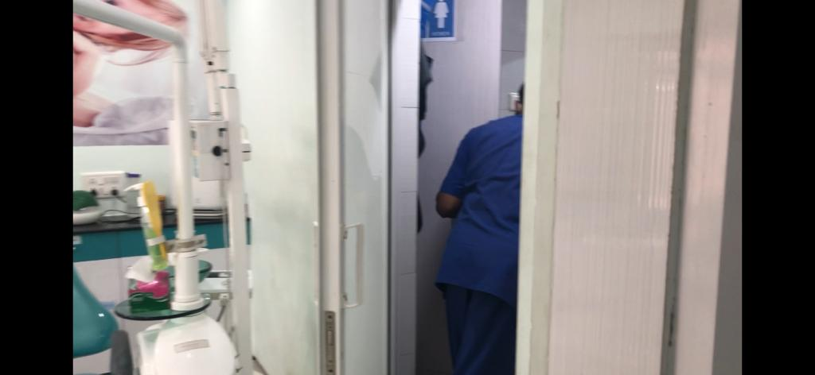
CONDUCT SEARCH IN WASHROOMS

Slide 14
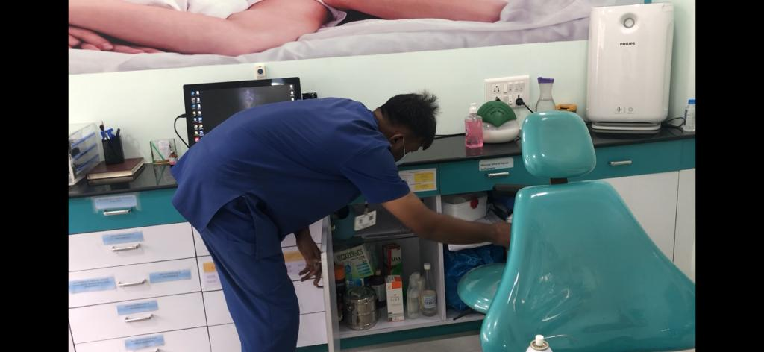
CONDUCT SEARCH IN DRAWERS OF OPERATING AREA

Slide 15
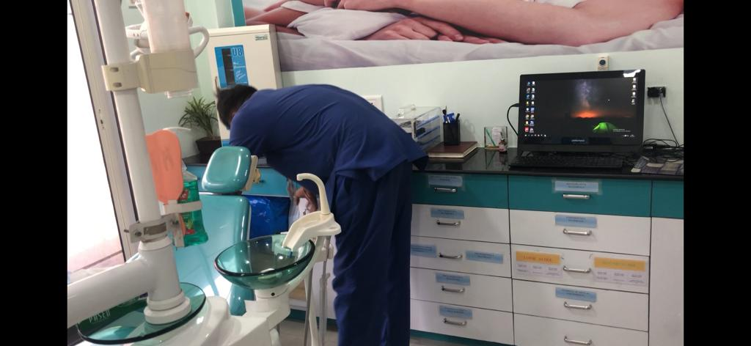
SEARCH EVERY CORNERS AND DRAWERS IN OPERATING AREA

Slide 16
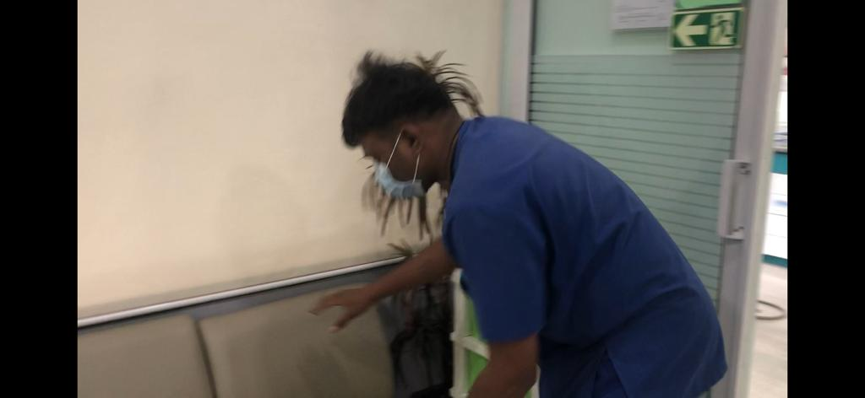
CONDUCT TO SEARCH IN CONSULTING AREA

Slide 17
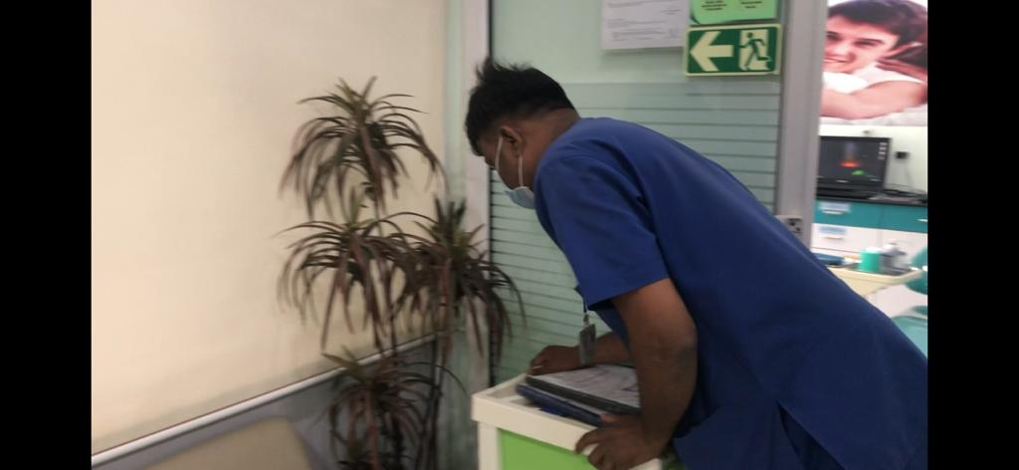
CONDUCT TO SEARCH CORNERS OF CONSULTING AREA

Slide 18
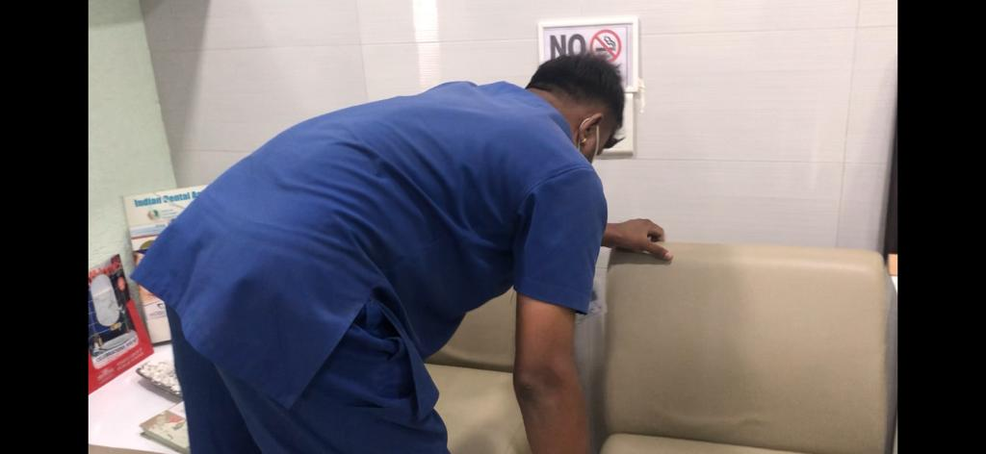
CONDUCT SEARCH IN SITTING AREA OF PATIENT

Slide 19
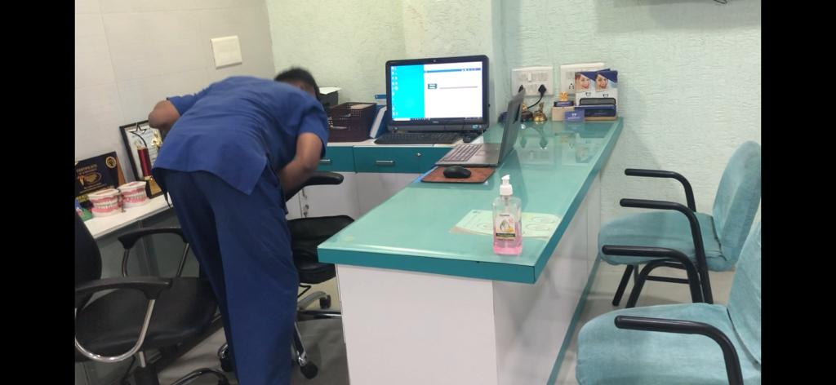
CONDUCT SEARCH BEHIND TABLE

Slide 20
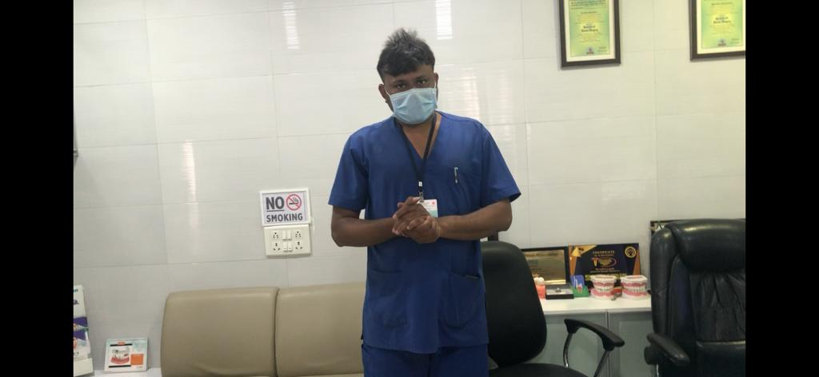
INFORM ALL STAFF TO MEET AT ASSEMBLY POINT

Slide 21
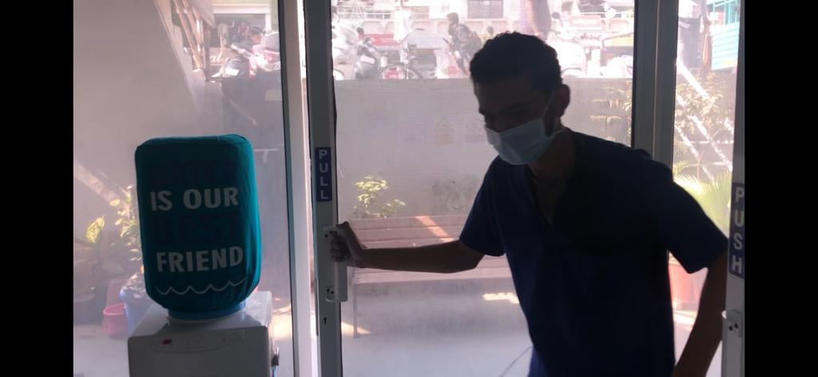
OPEN DOOR TO MEET AT ASSEMBLY POINT

Slide 22
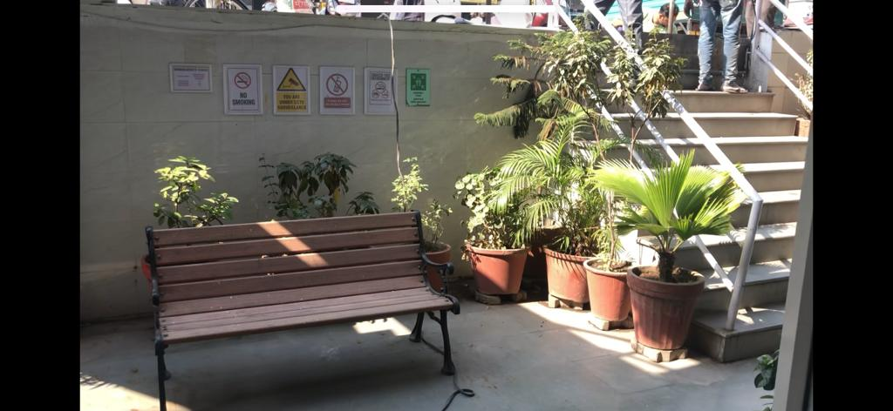
ASSEMBLY POINT OF CLINIC

Slide 23
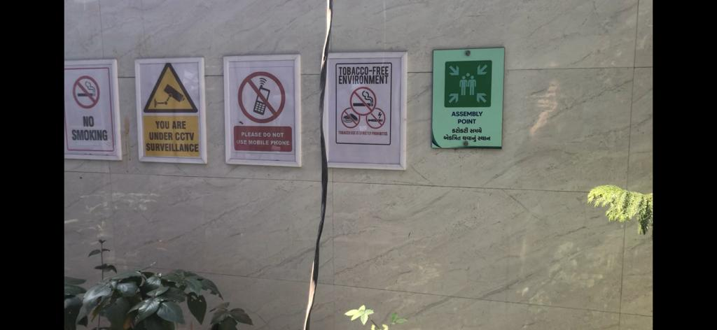
SIGNAGE OF ASSEMBLY POINT

Slide 24
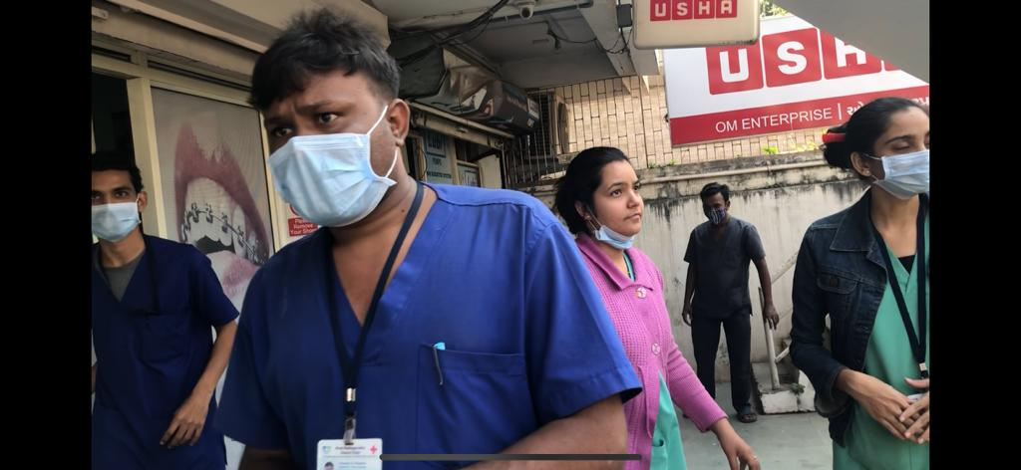
REACHED ALL STAFF AT ASSEMBLY POINT

Slide 25
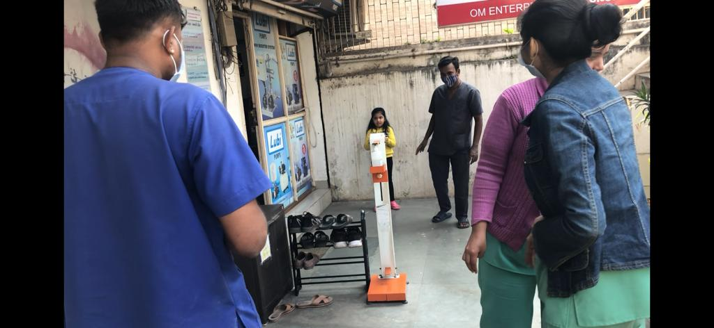
NOTICED CHILD AND INFORM TO HER MOTHER

Slide 26
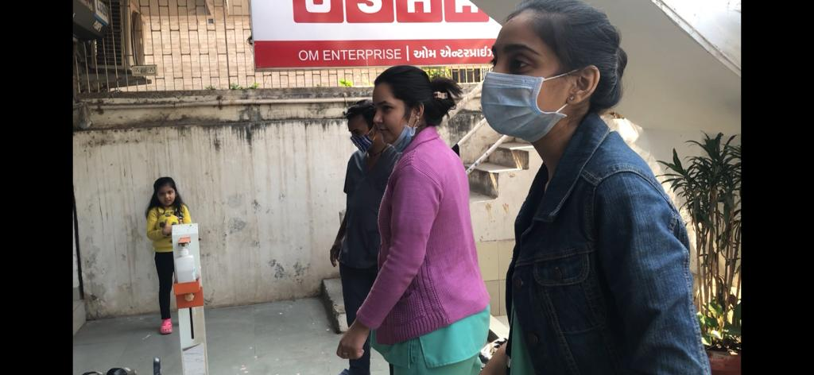
AFTER FIND OUT MISSING CHILD DEACTIVATE CODE PINK

