Slide 1
CODE BROWN – MOCKDRILL
SPILLAGE MANAGEMENT

Slide 2


1
Announcement for Code Brown and activating it 3 times with exact location of spillage and size of spillage.
Informed to reception desk by speed-dialing no.02

Slide 3
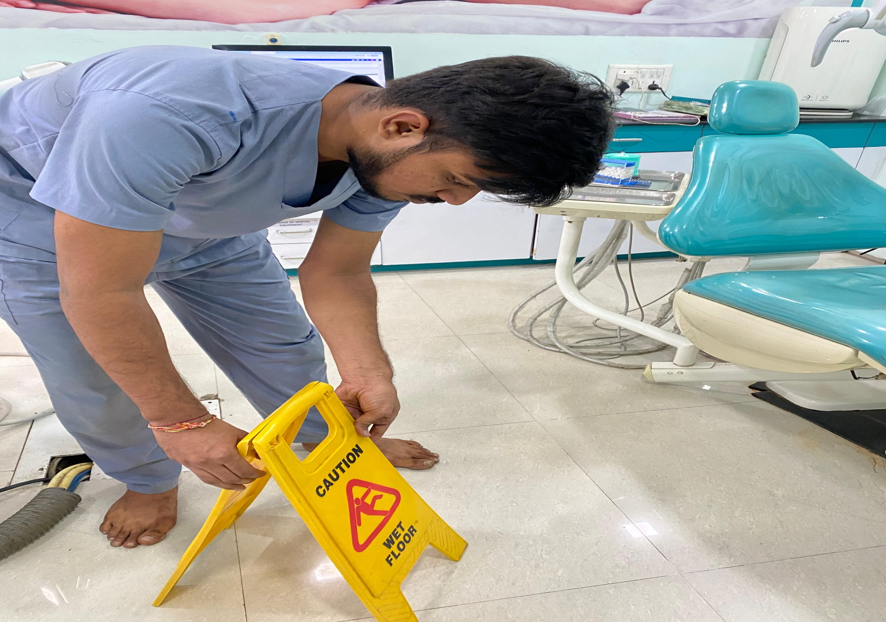
2
Inspect and restrict the activity at Spill site.
Restricting the area with signage of spillage or wet.

Slide 4
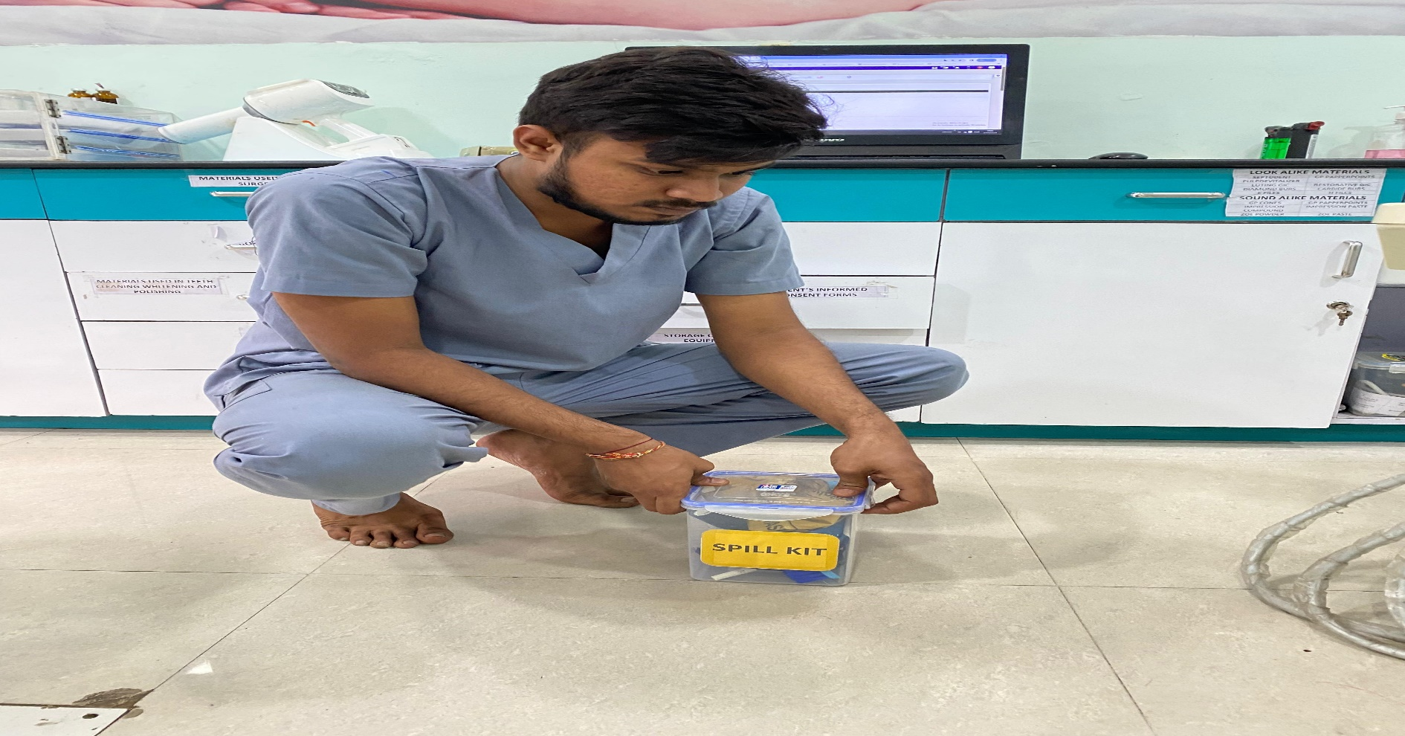
3
Bringing the spillage kit at the site of spillage.

Slide 5
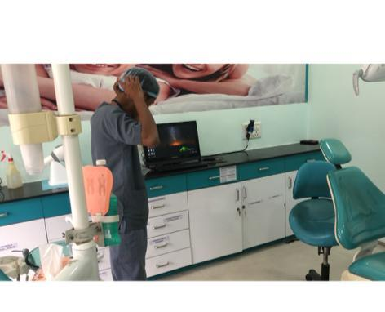
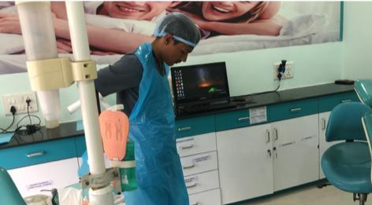
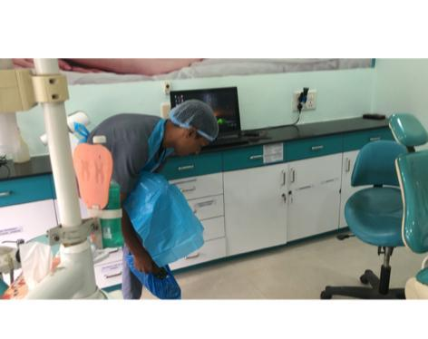
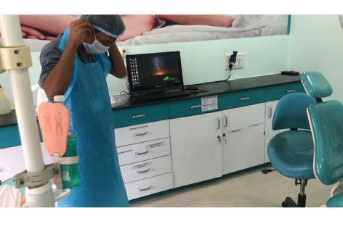
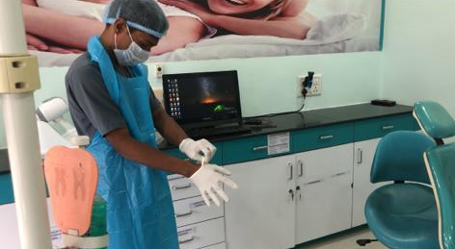
4
WEAR PPES BEFORE SPILLAGE MANAGEMENT - DONNING OF PPE STEPS:
Head cap
Disposable Apron
Shoe cover
Face mask
Disposable Gloves

Slide 6
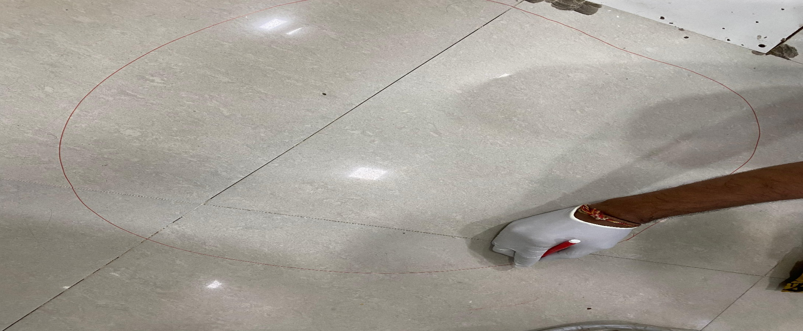
5
Marking the area with marker 2 feet away from the spillage area.

Slide 7
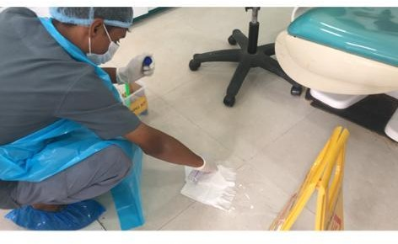
6
Keeping absorbent tissue paper at the area of spillage.
Confine & cover the spillage with absorbent material (tissue paper/ wastage cloth/ wastage gauze piece).

Slide 8
7
Freshly Prepared 1% Hypochlorite solution at the spillage site from outside to inside

Slide 9
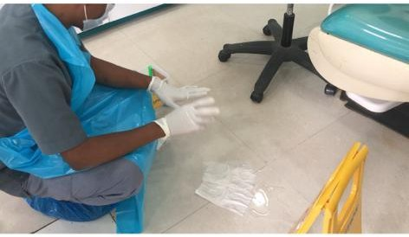
8
Wait for 10-15 minutes. Allow 10-15 minutes exposure time with disinfectant.

Slide 10
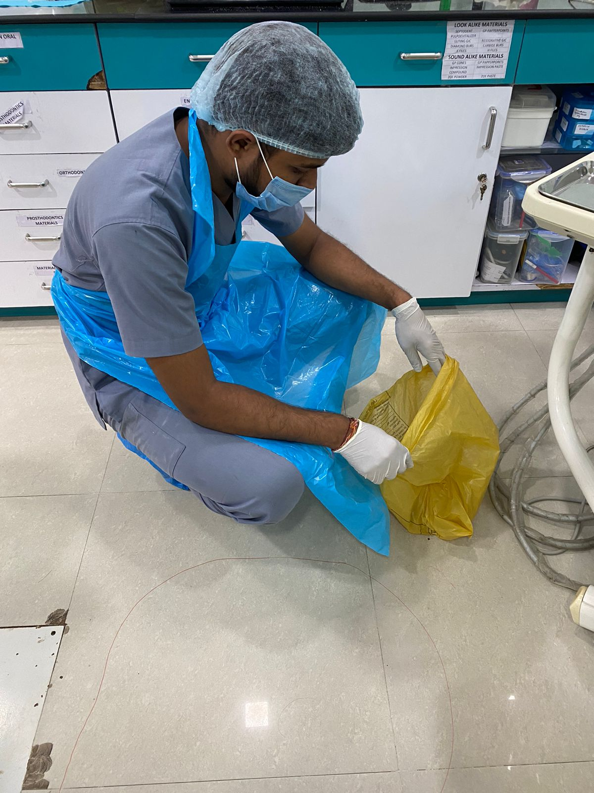
9
Taking out the yellow garbage from spillage kit.

Slide 11
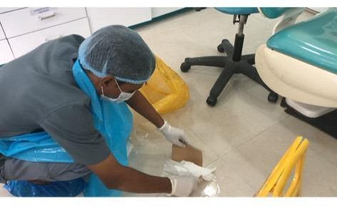
10
Carrying all the spillage and tissue with the help of cardboard and throw it in he yellow bag.

Slide 12
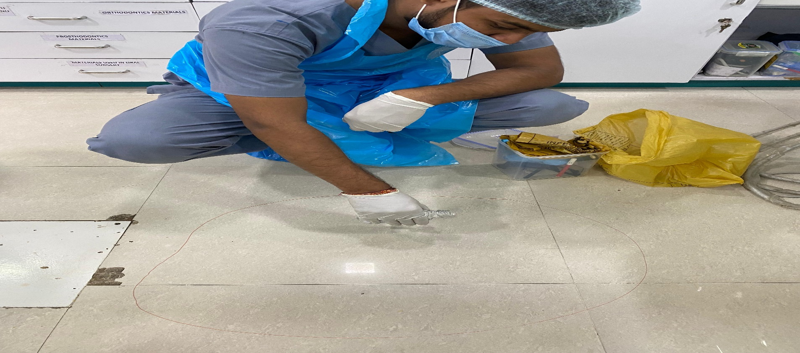
11
Pouring the solution again at the spillage area.

Slide 13
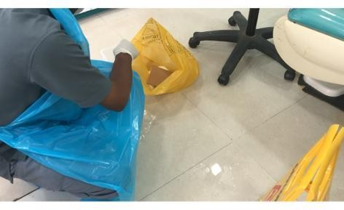
12
Again wait for again 5-10 minutes.

Slide 14
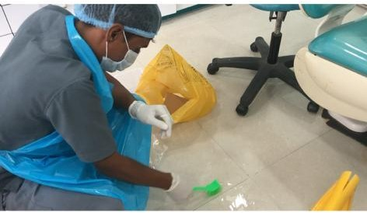
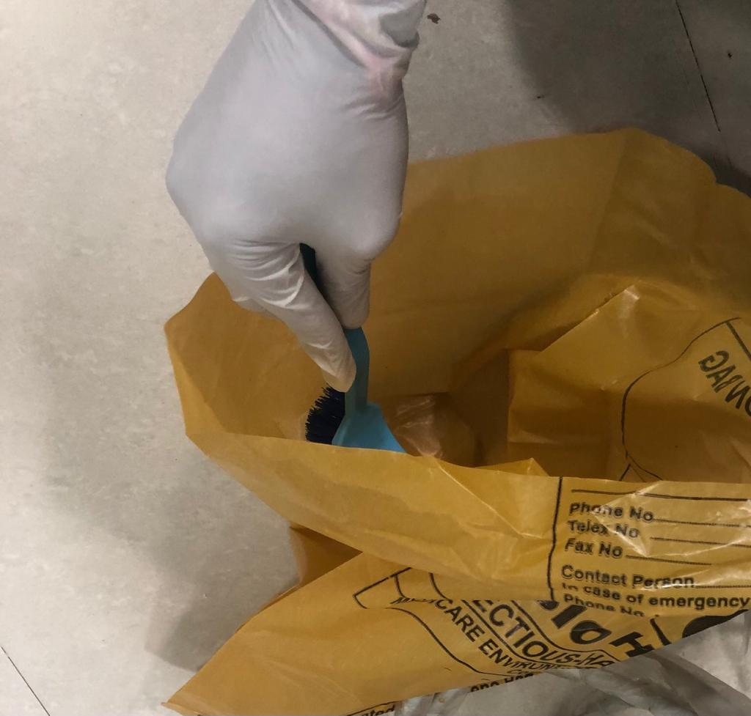
13
Cleaning with the brush from outside to inside in circular motion.

Slide 15
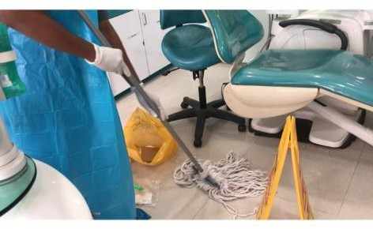
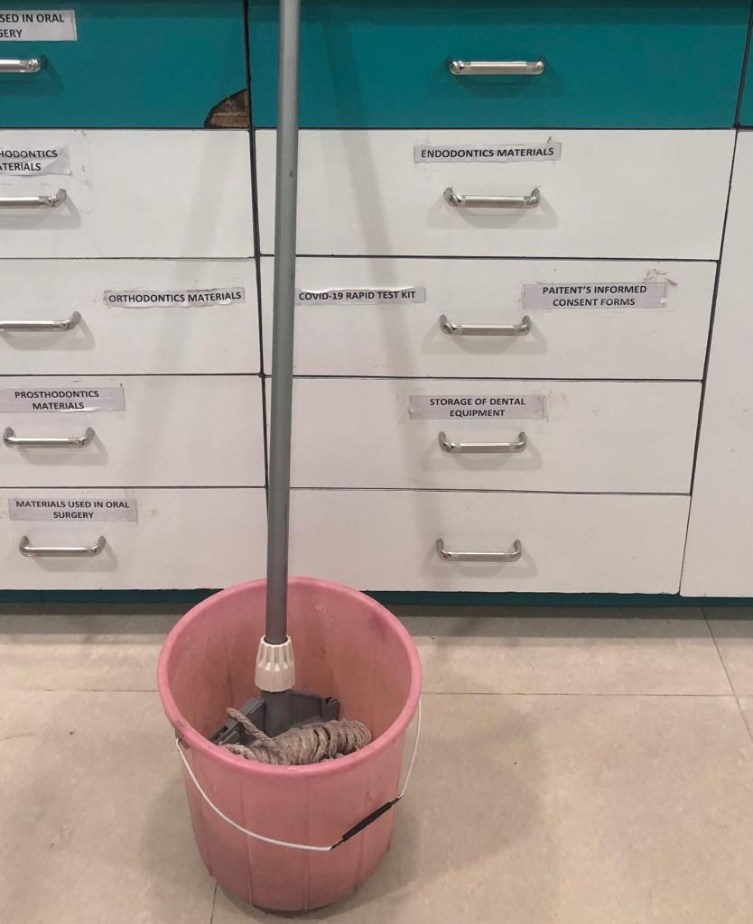
14
Moping at the spillage site from outside to inside in small circular motion.

Slide 16
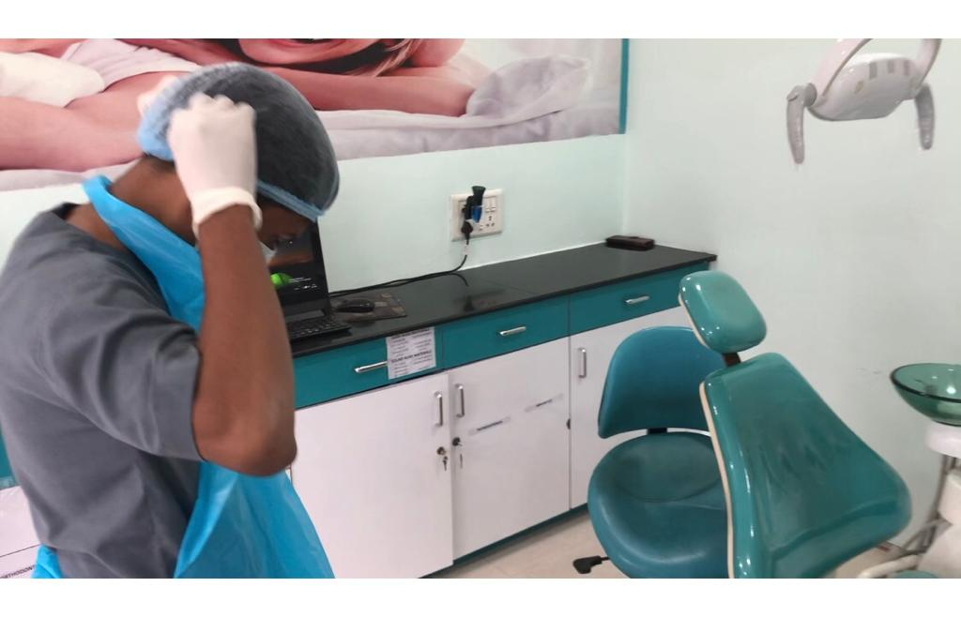
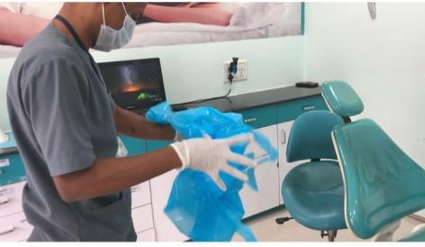
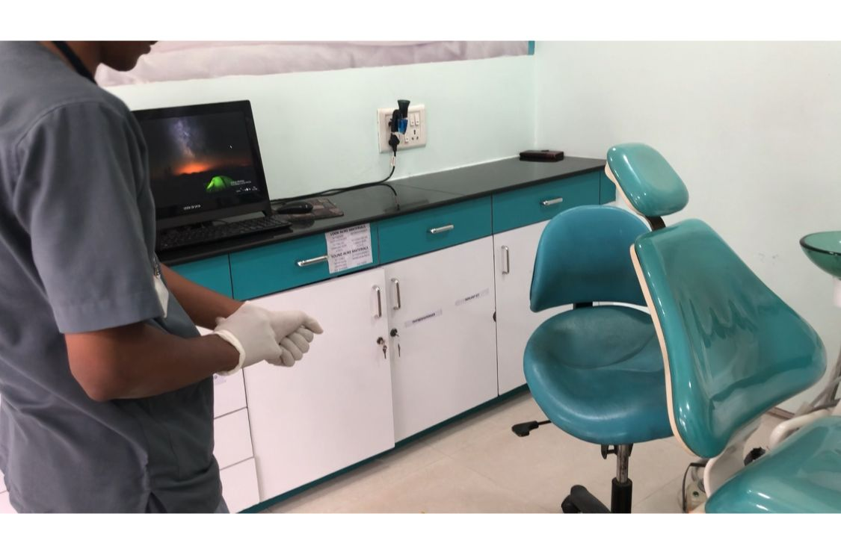
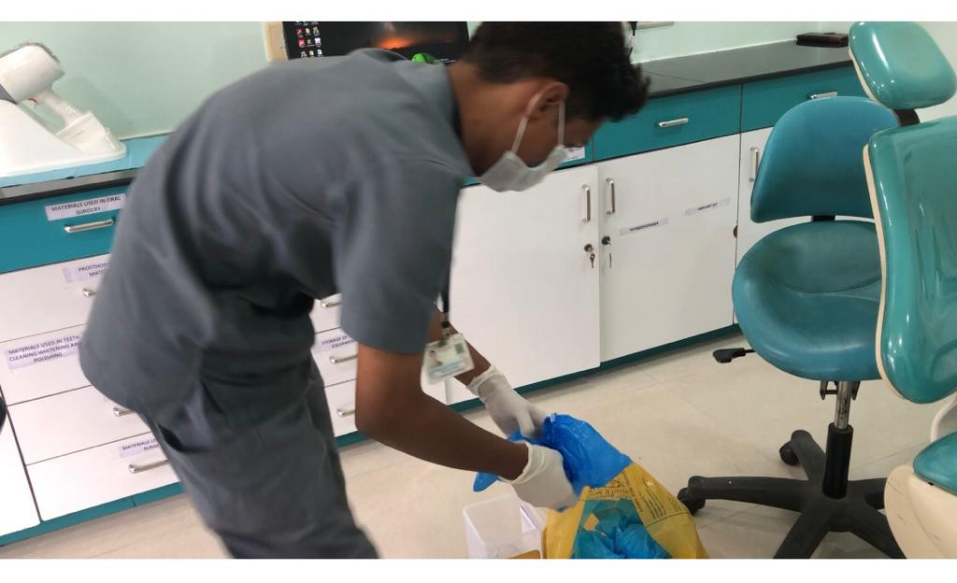
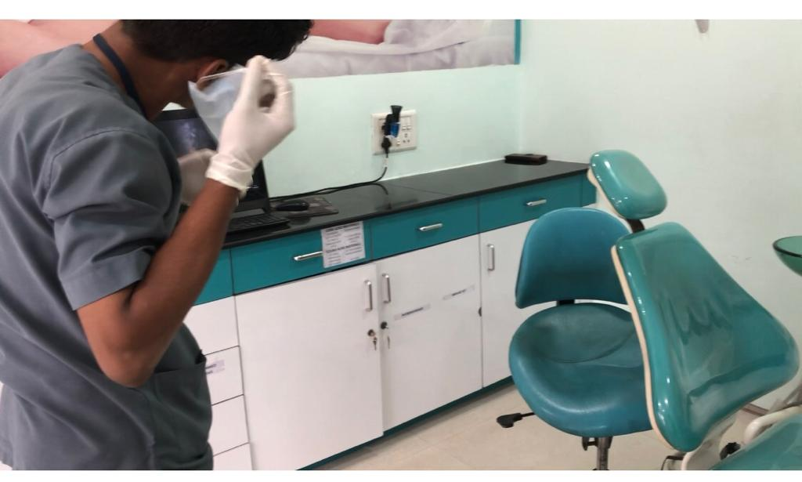
15
Doffing off the PPE kit.

Slide 17
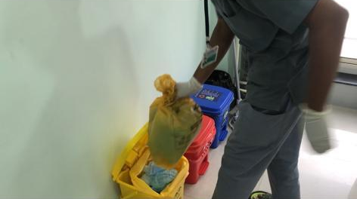
16
Used PPE kit discard in yellow color BMW bin.

Slide 18
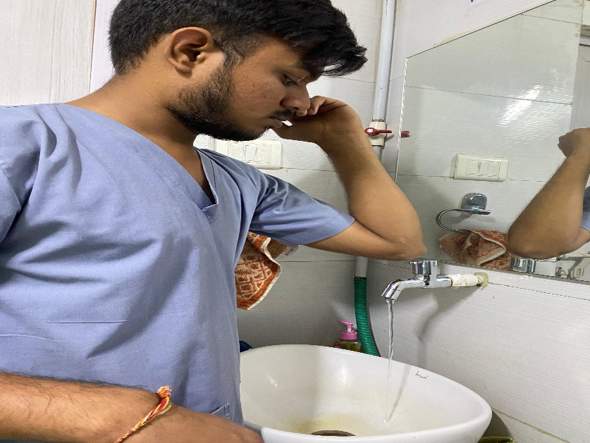
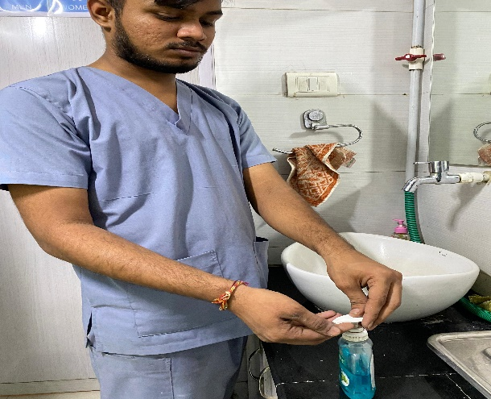
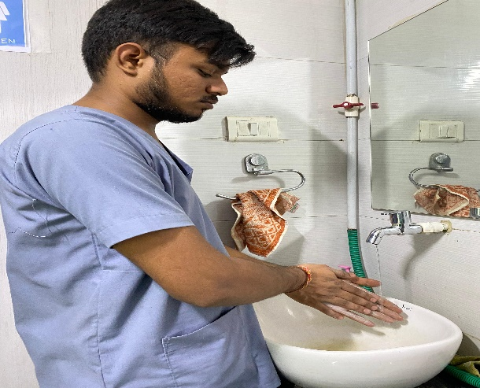
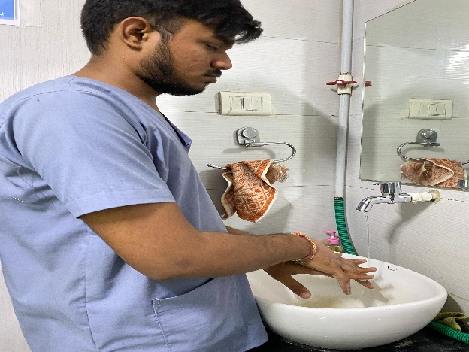
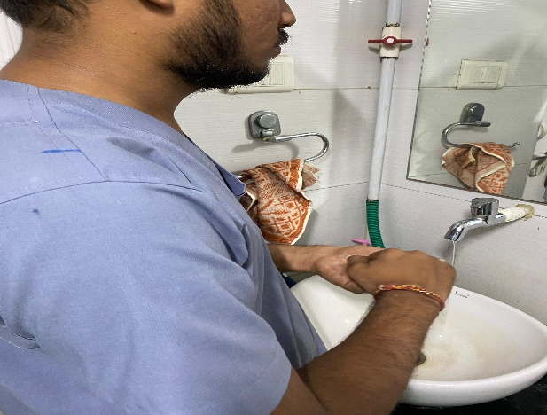
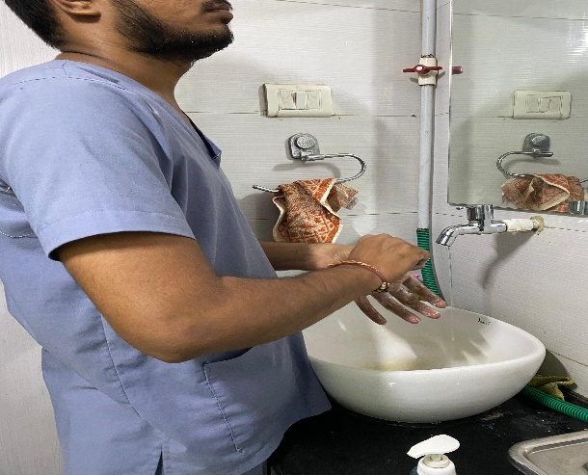
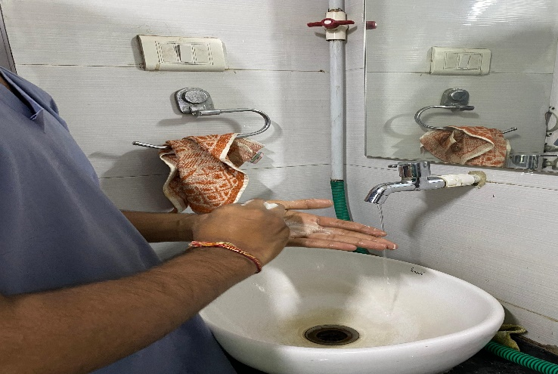
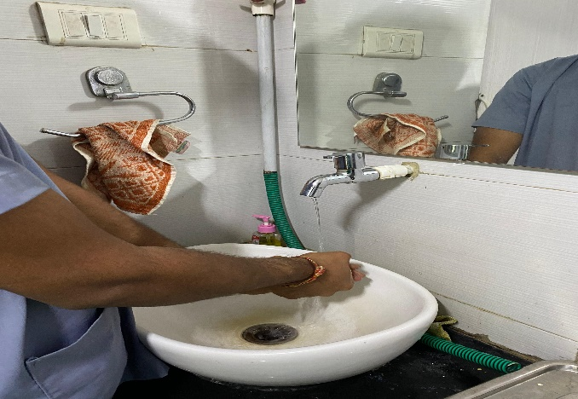
17
Hand washing

Slide 19
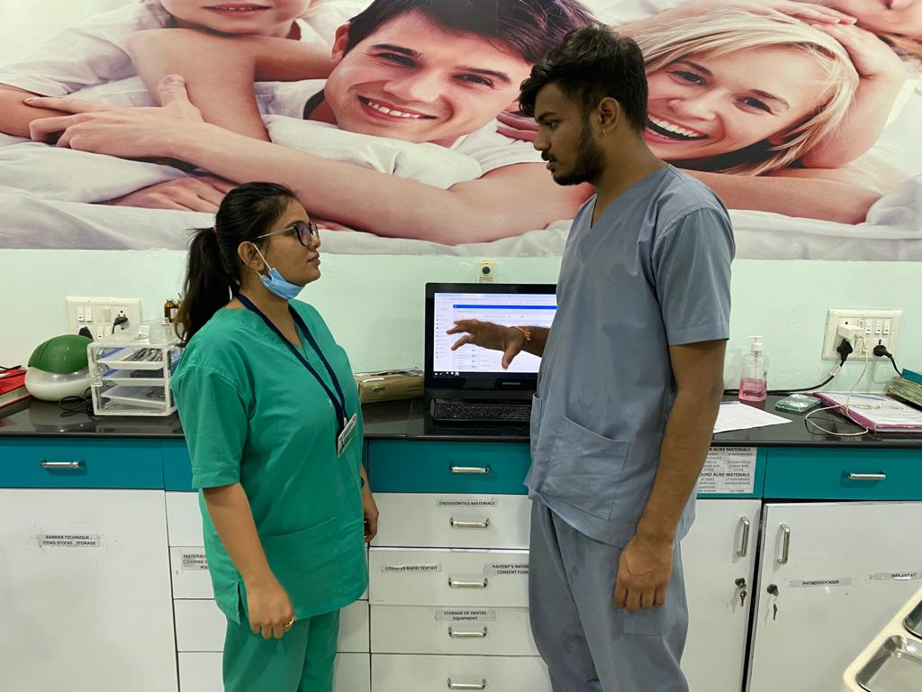
18
Informing the safety officer for deactivating the code.

Slide 20
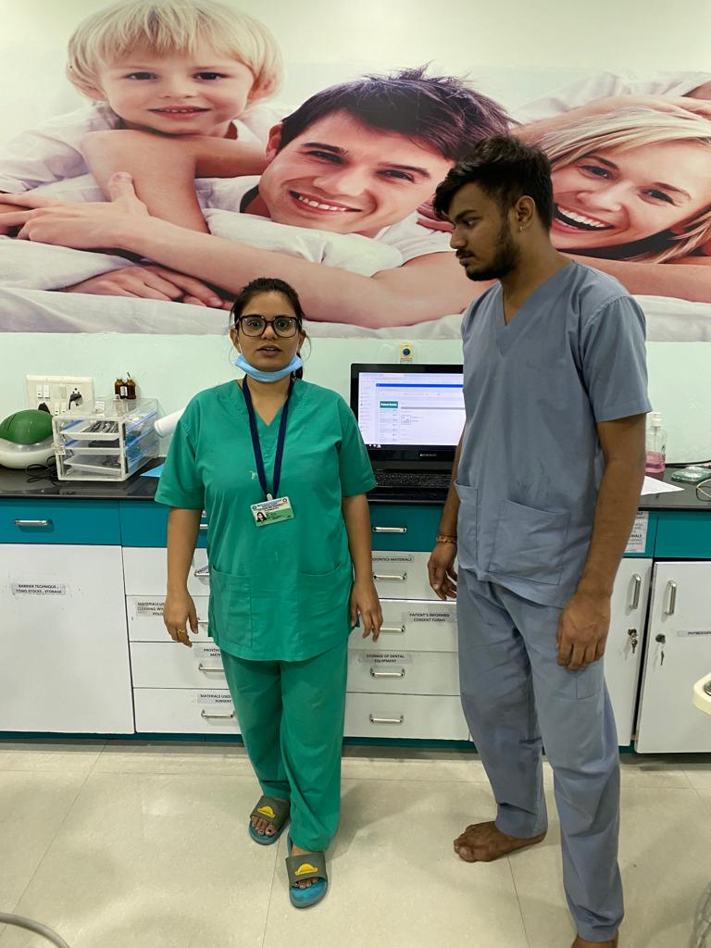
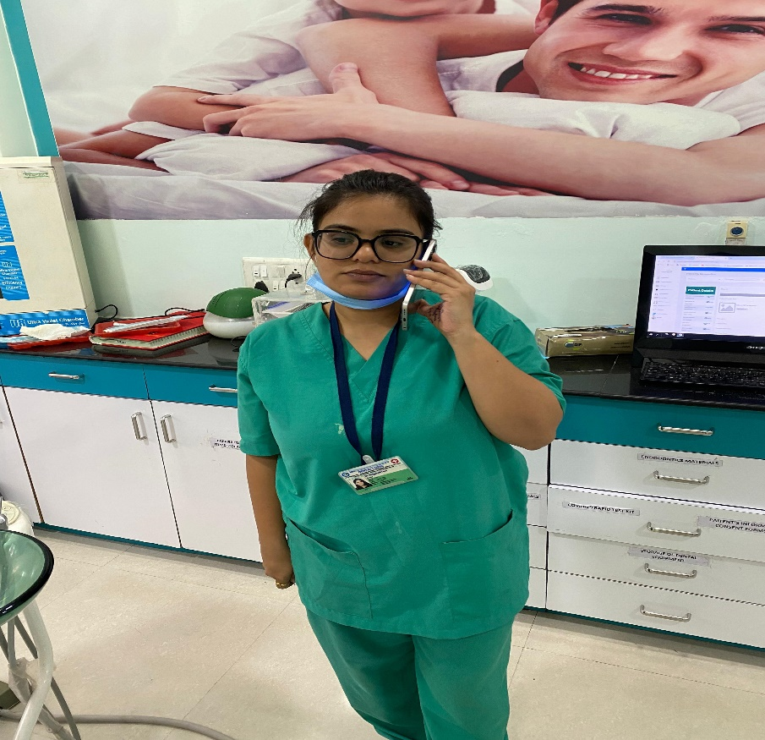
19
Safety officer announce 3-times for deactivating the code.
Also speed dial no-2, to inform reception desk for same.

Slide 21
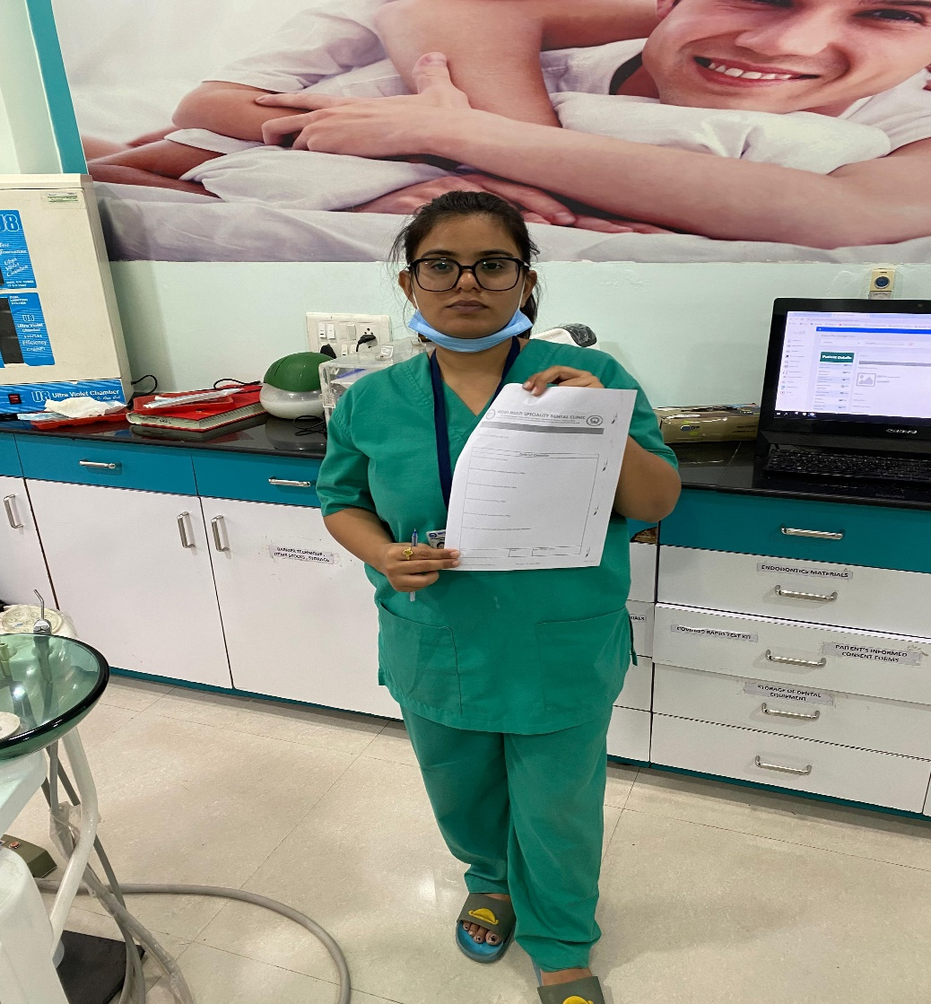
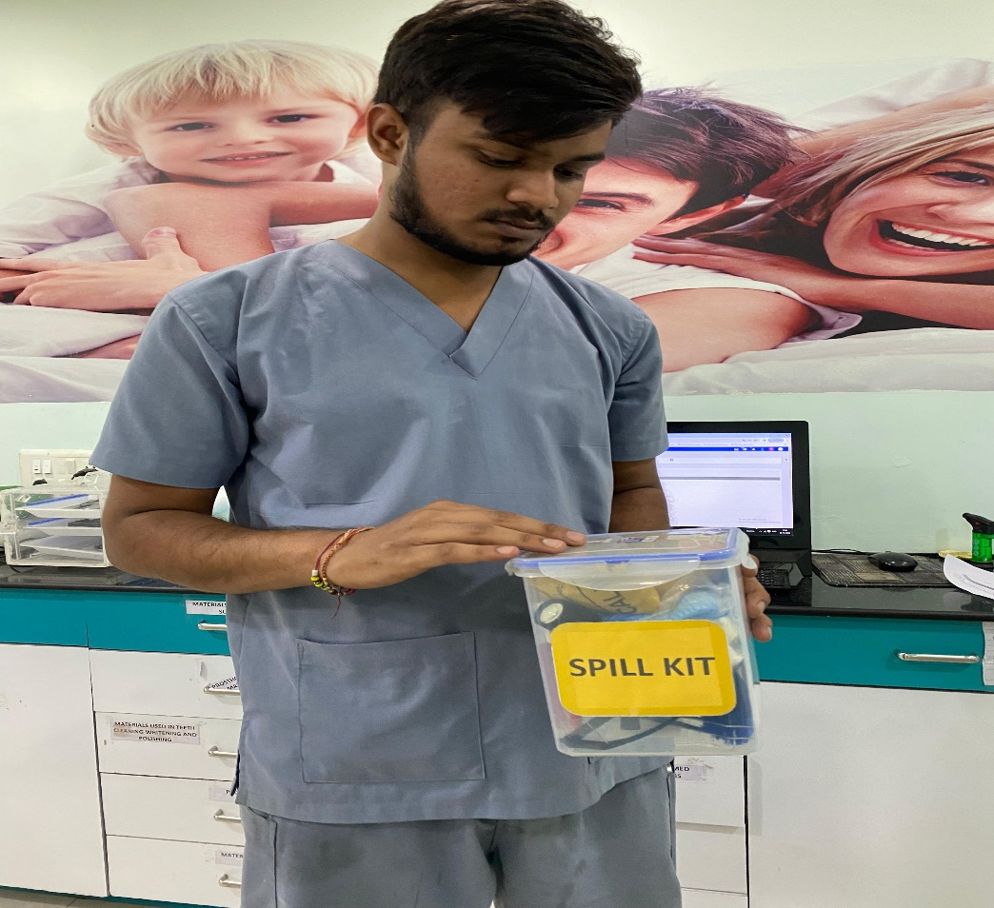
20
Safety Officer shall Report this incident.
Dental Assistant staff refill the Blood Spillage Kit.

Slide 22

9
Incidents/Mock-drill need to be reviewed and reported in decided format (form), which later verify by authorized person. Necessary corrective and preventive actions and measures shall be taken.

